Slide 1
DND Live Image Generator
DIGCRE
Cyrill Tschopp / Alexander Wyss

Slide 2
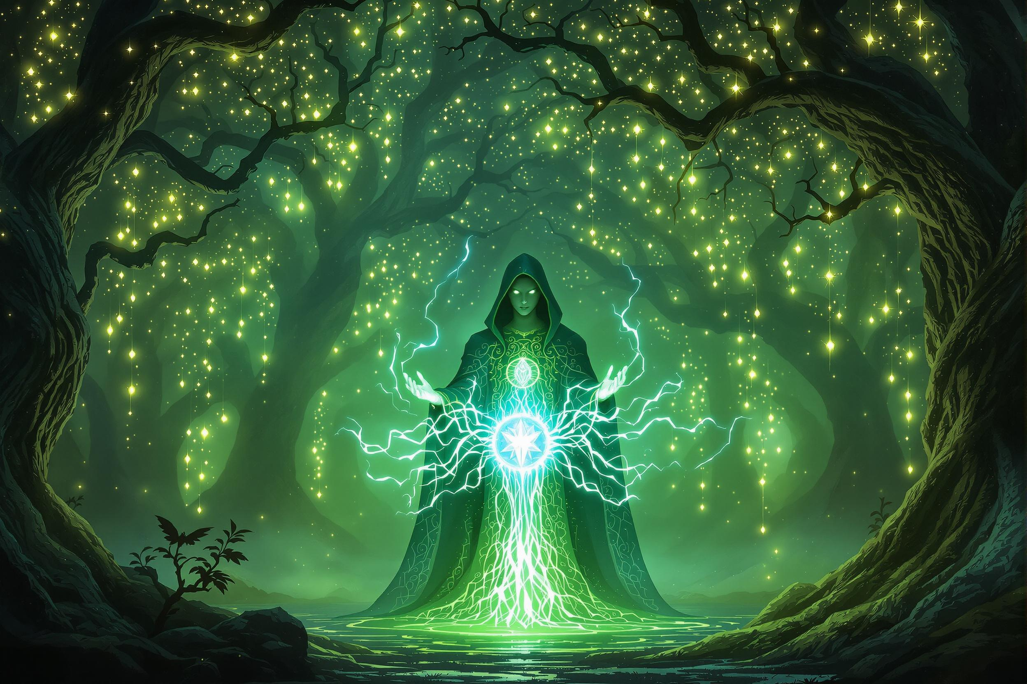
Project
Listen to a DND Session
Generate and Display Images based on what is happening

Slide 3
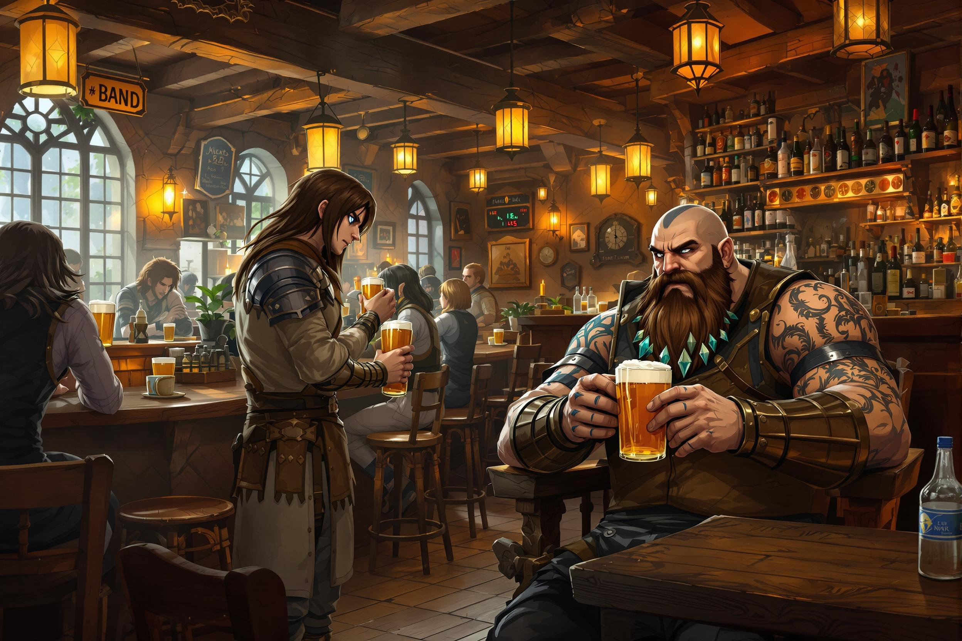
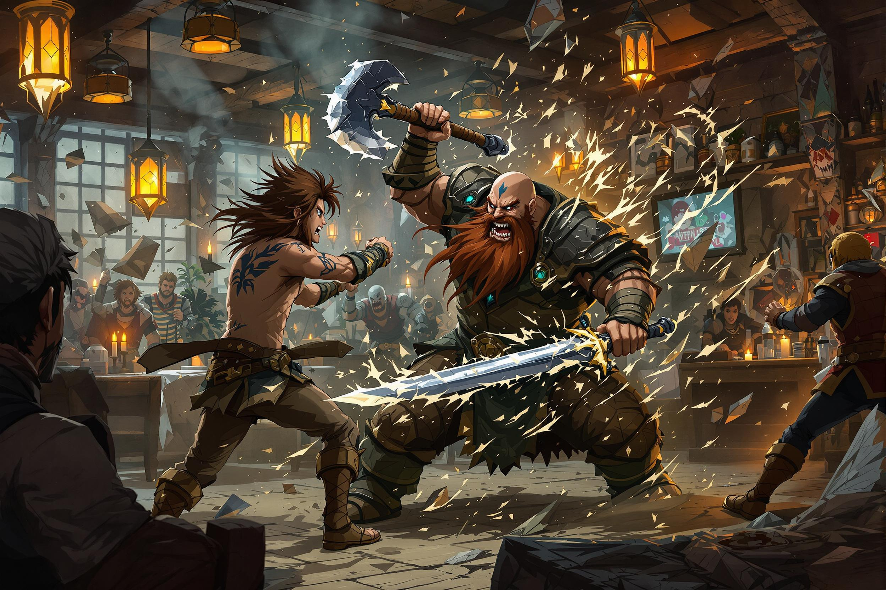

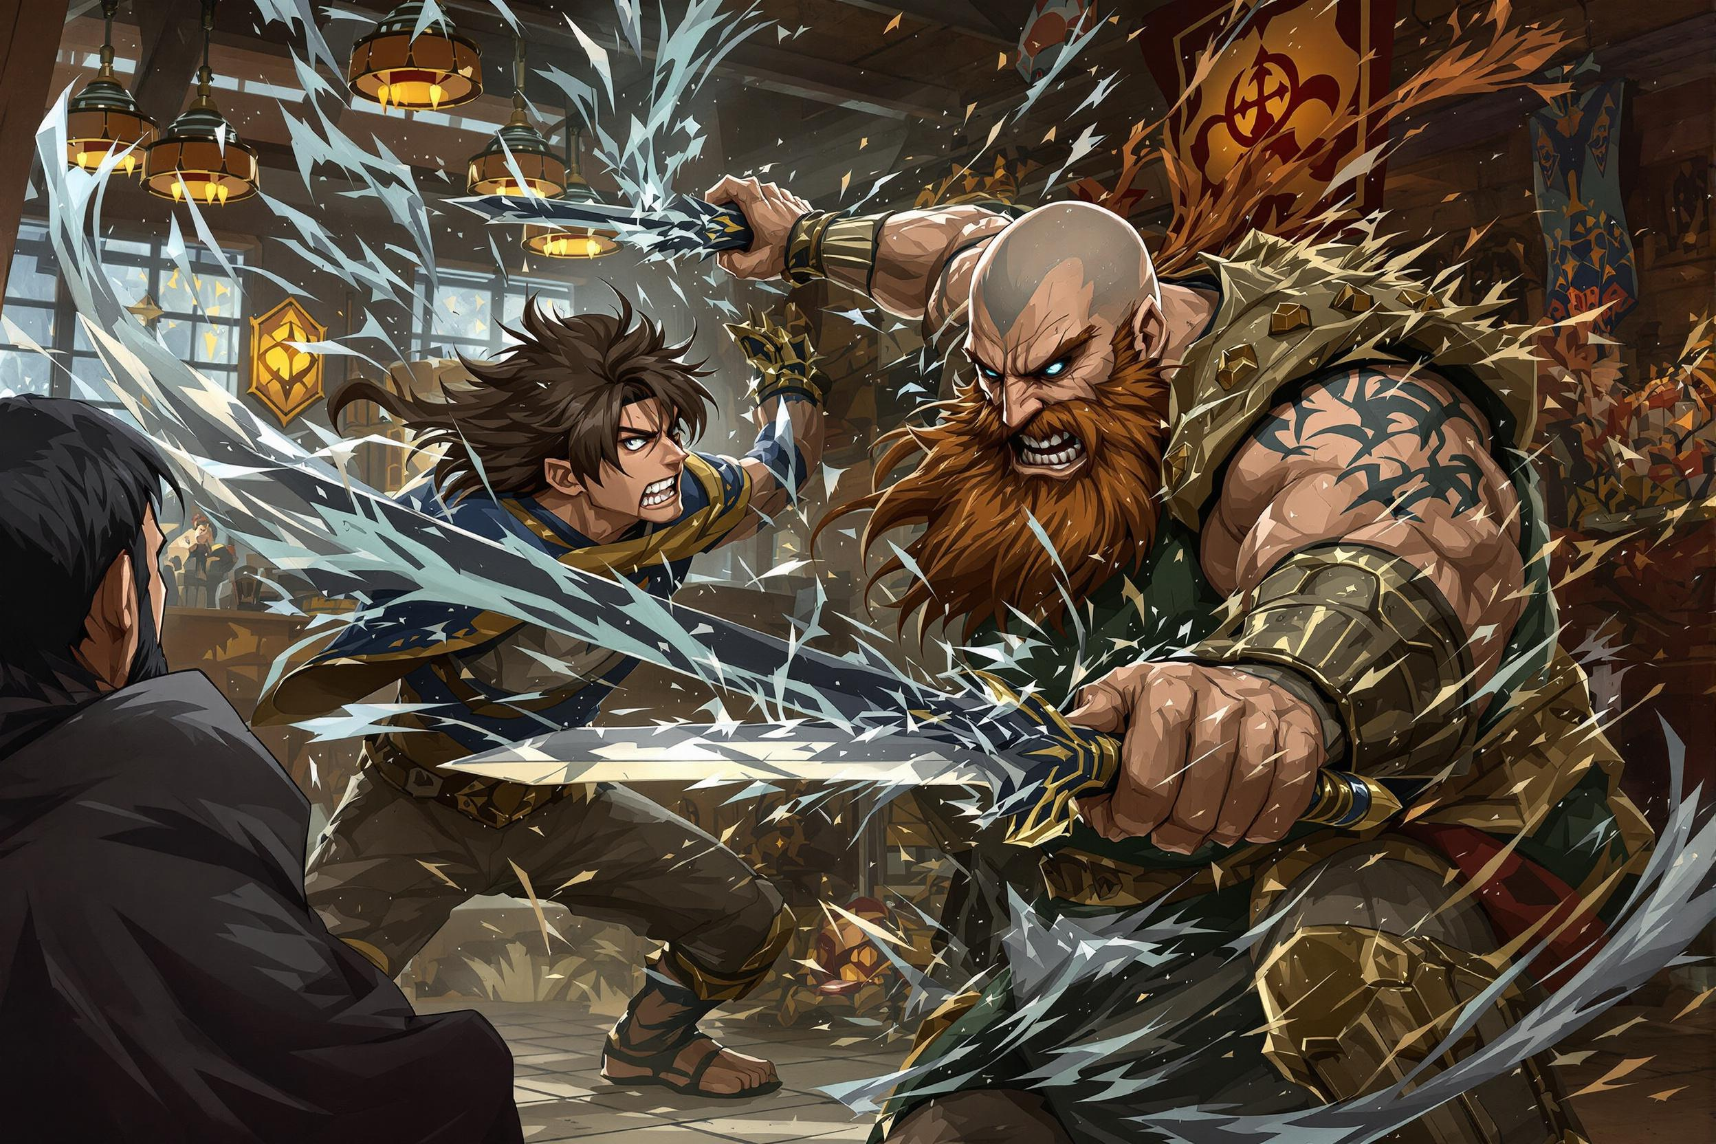
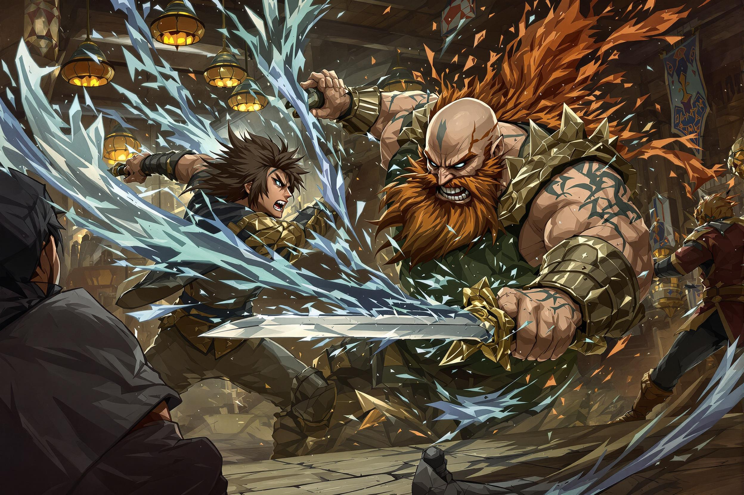
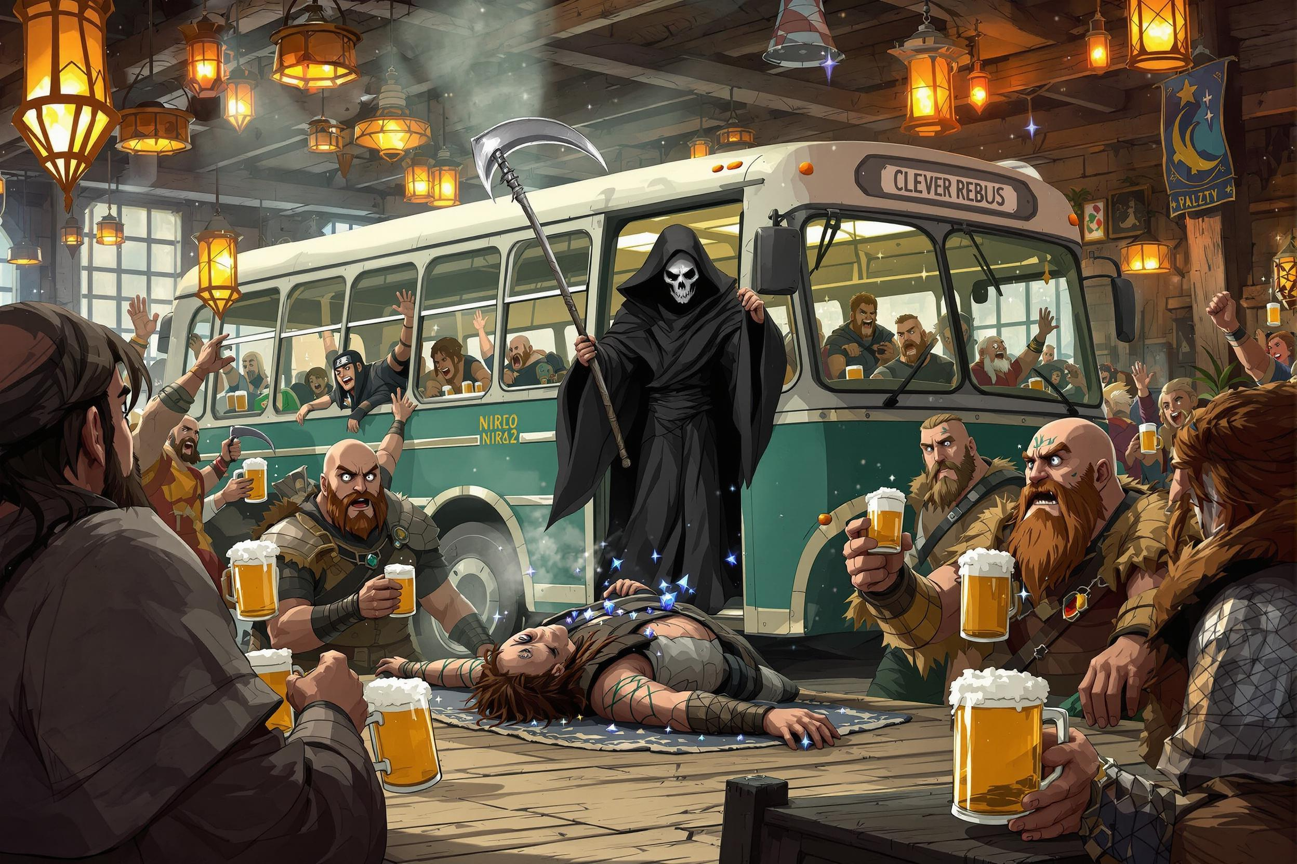
Demo

Slide 4
Pipeline
Record
Speech to text
Prompt generation using LLM
Generate Image using Prompt
Display Image

Slide 5
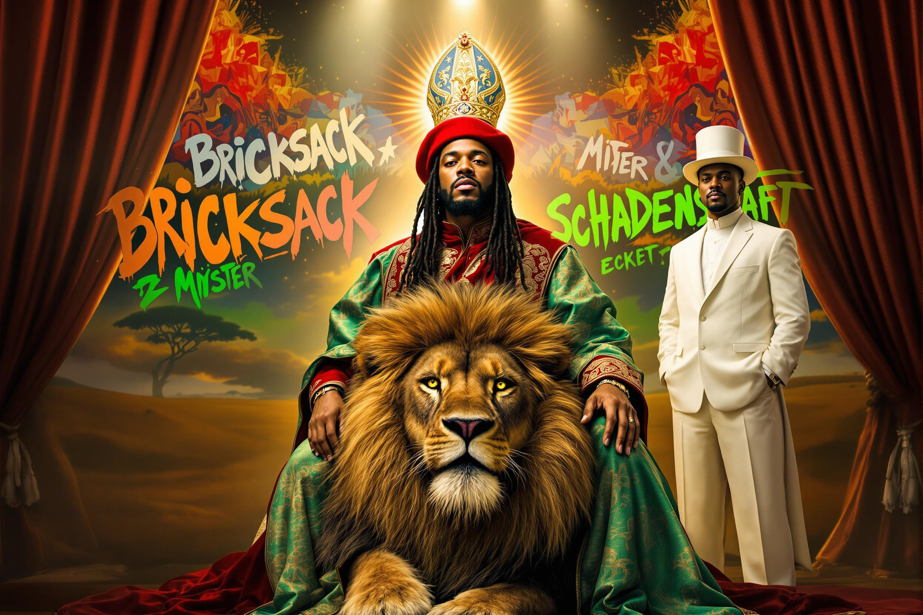
Record
Recording via Discord Bot
Each Person into separate Audio File
1-2 min long recordings

Slide 6
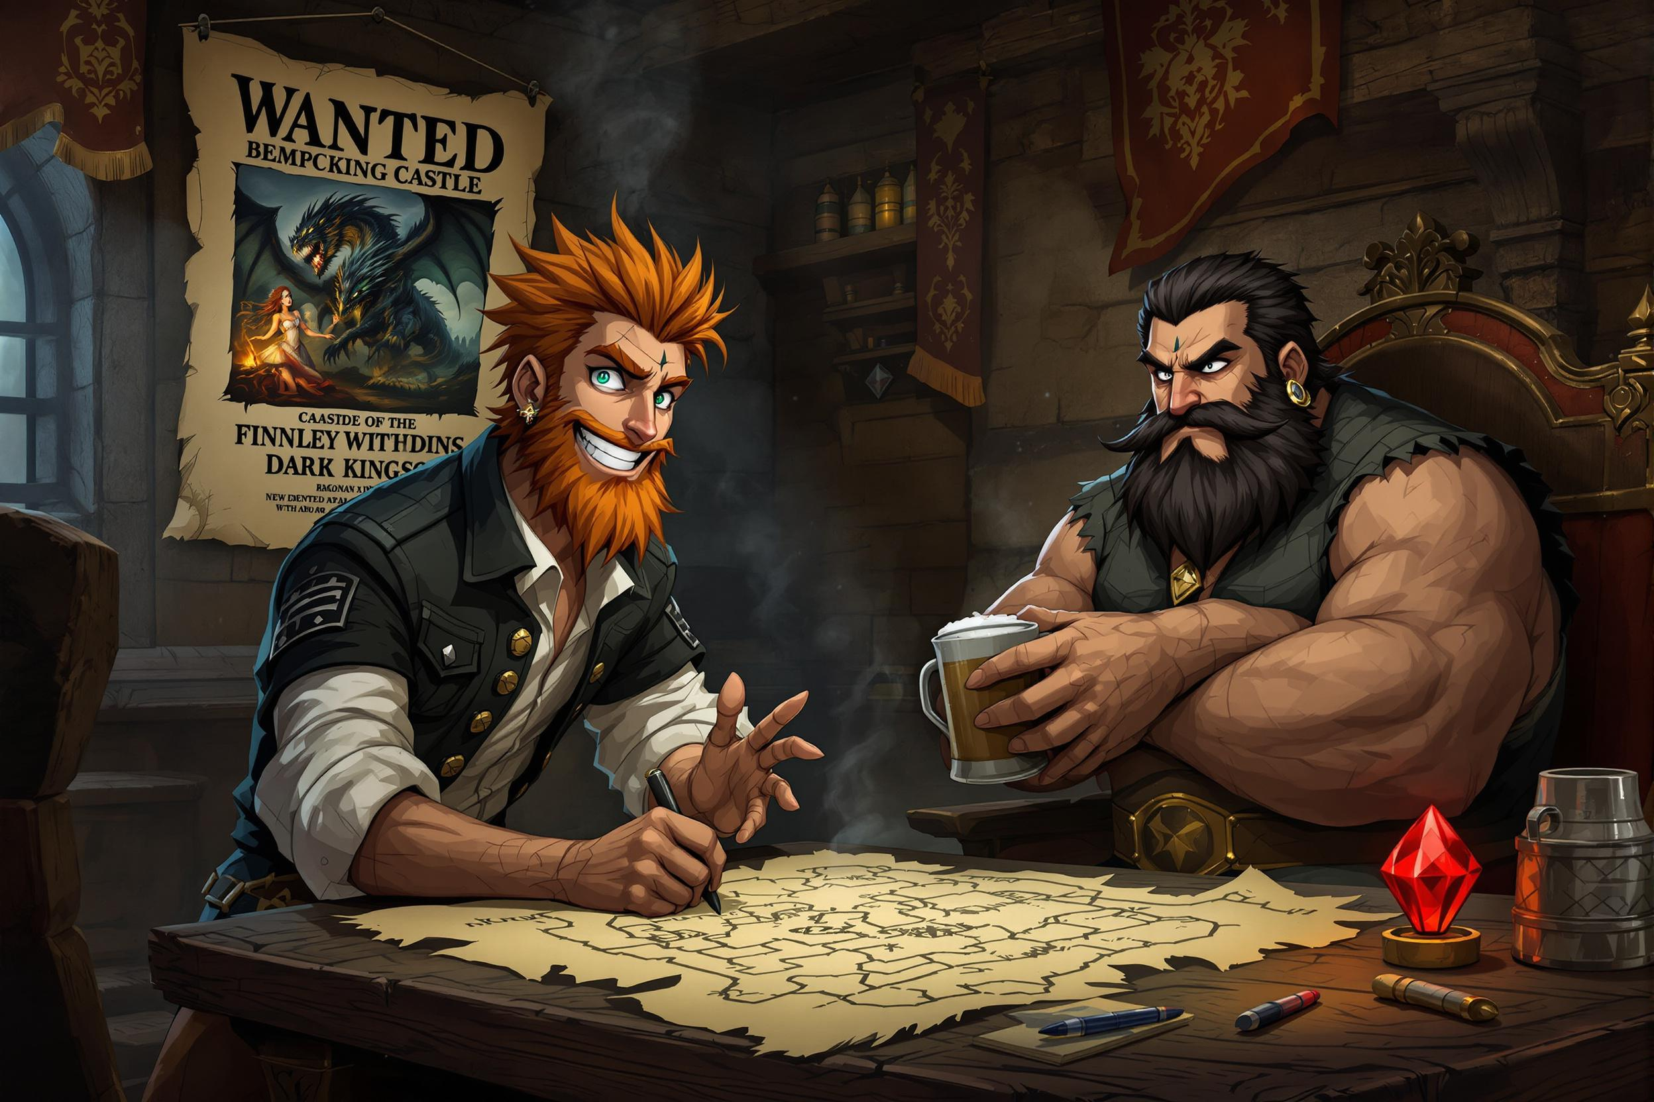
Speech to Text
Whisper OpenAI
Using Replicate
Language
English/German works well
Swiss German more problematic
Setting Language to German
Join transcribed texts
Based on segment start & end
Label segments with Discord Username

Slide 7
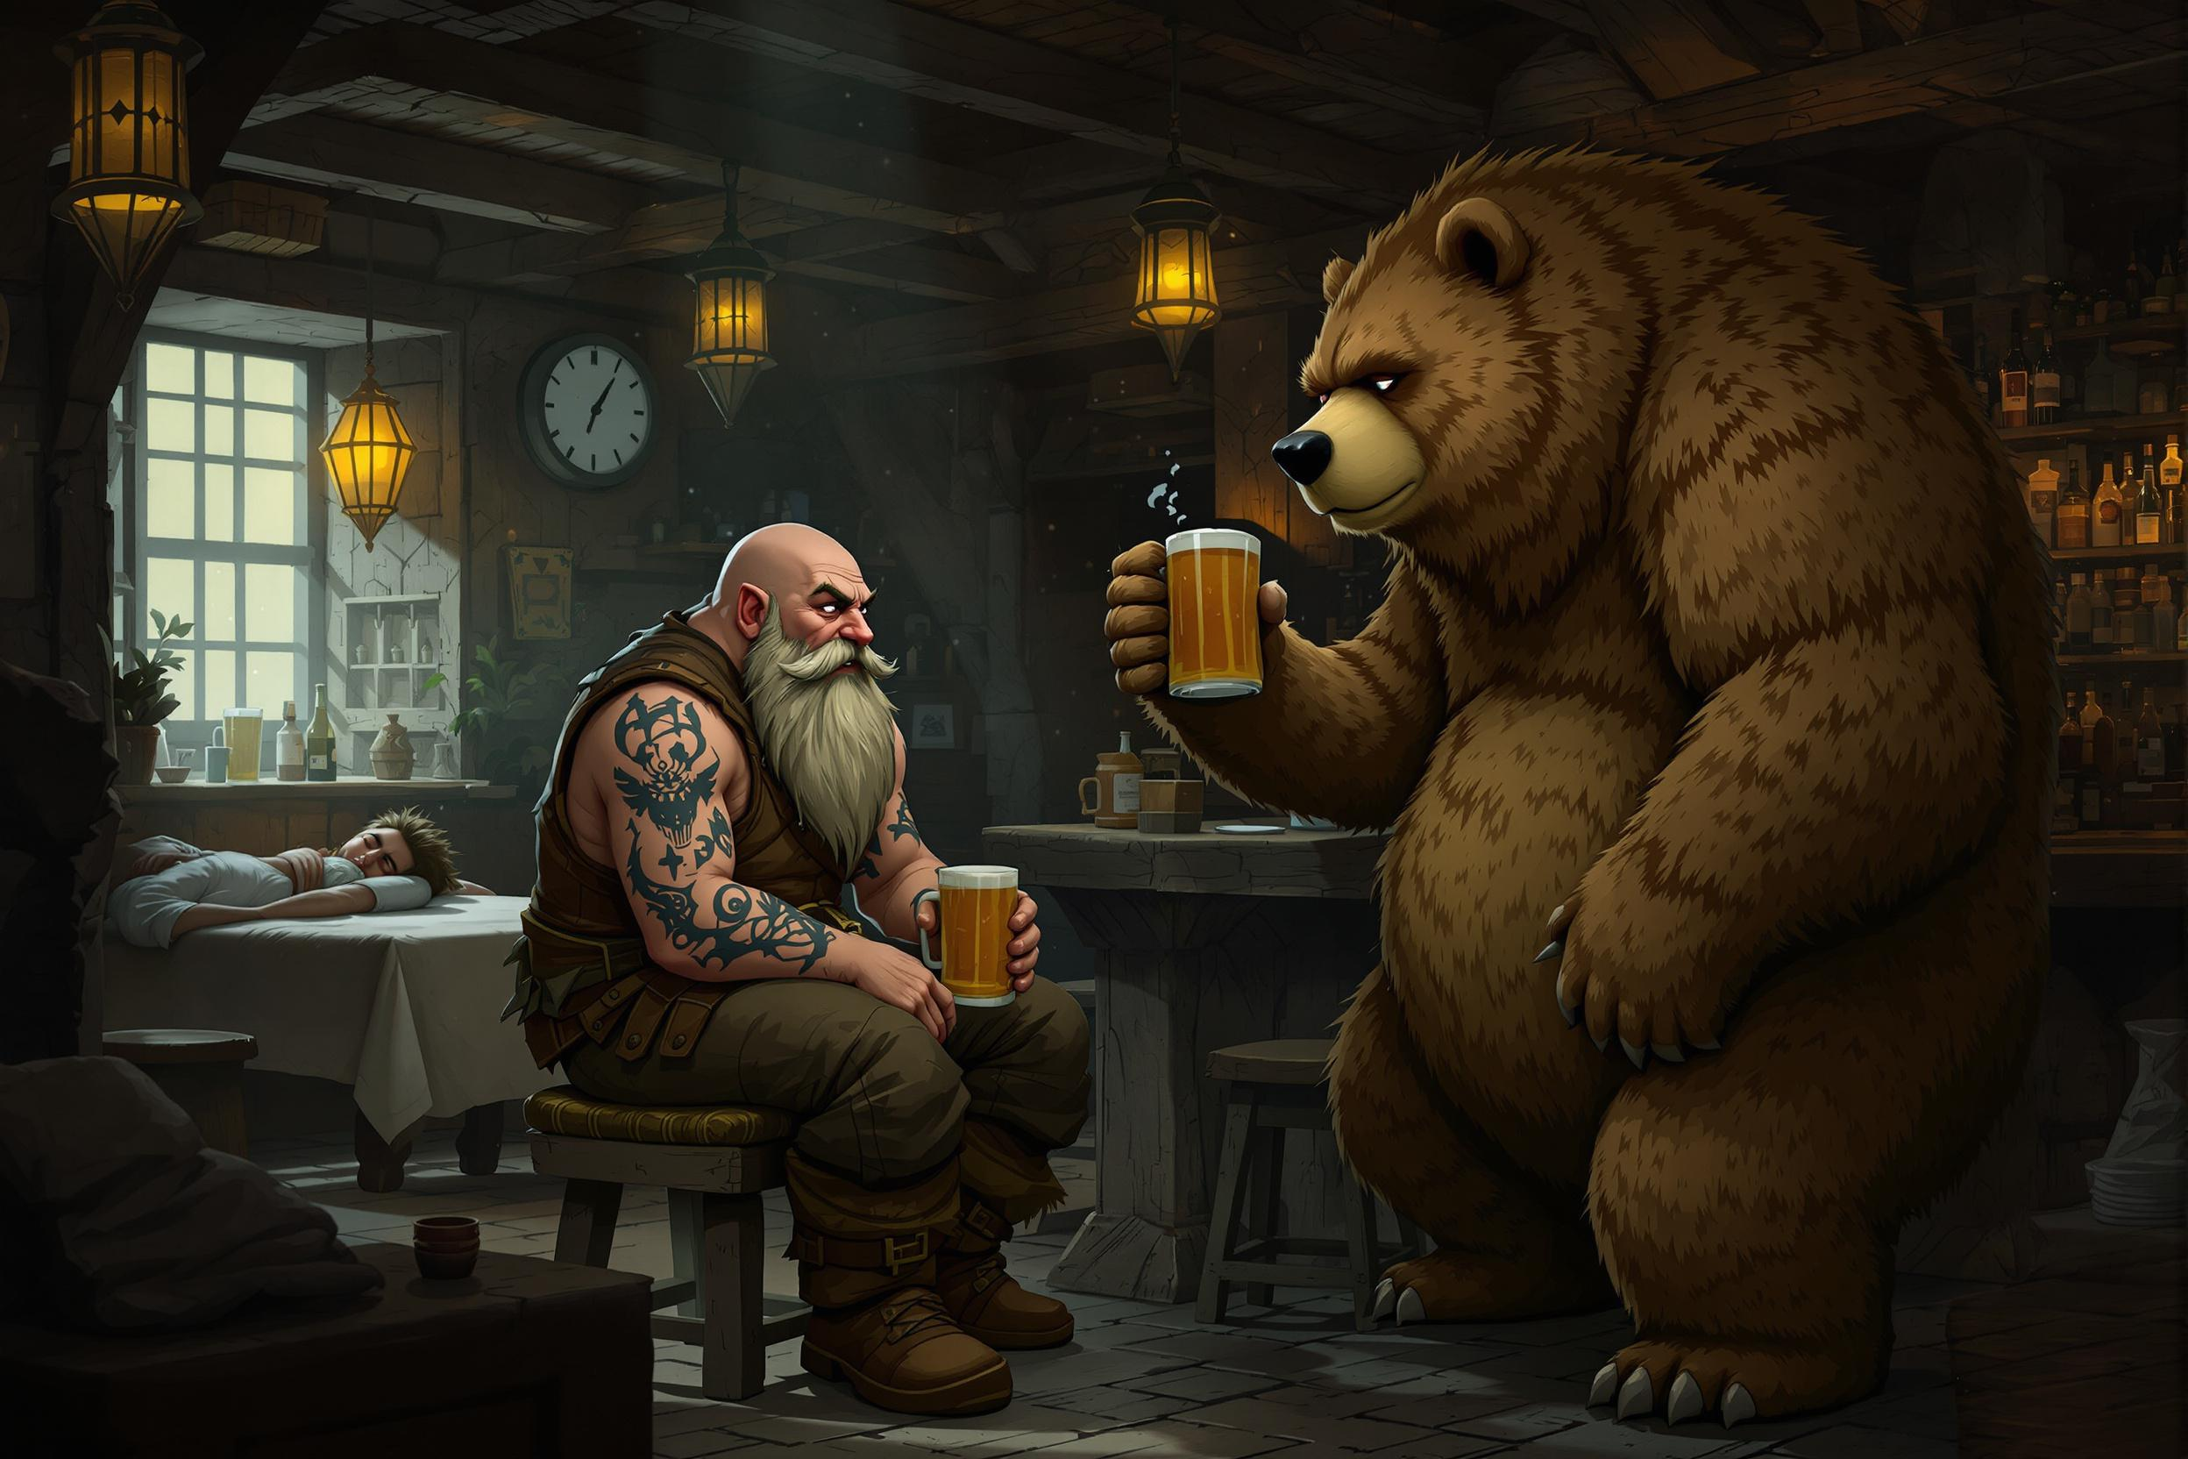
Large Language Model
Llama
Output of Transcription
Recent Prompts
Context

Slide 8
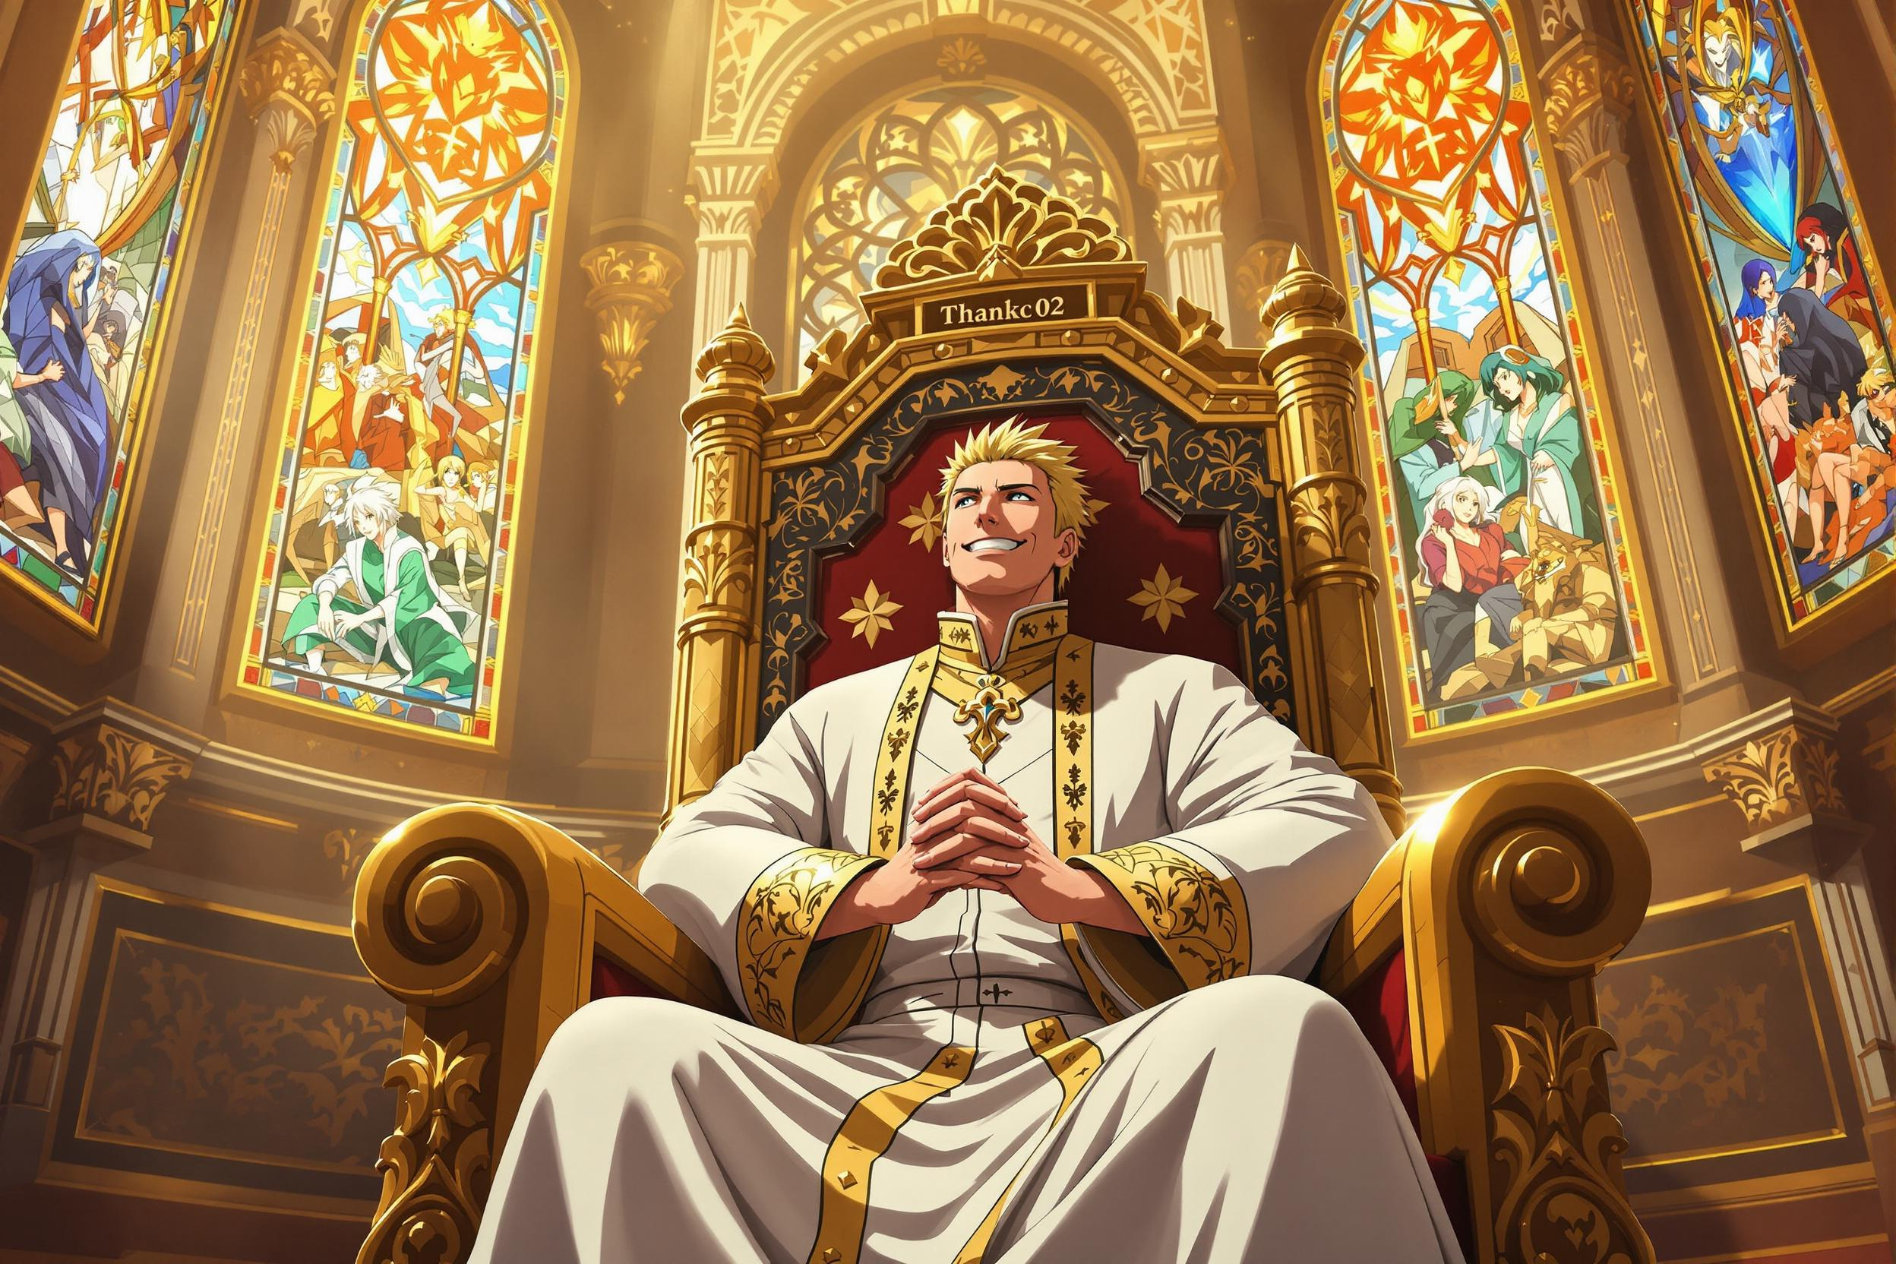
LLM: Prompting Context
Initial Context
Prompt Guidelines
Style
Setting
Roles
Character Description
Prior Prompts
Direct Instructions
Ouptput structure

Slide 9
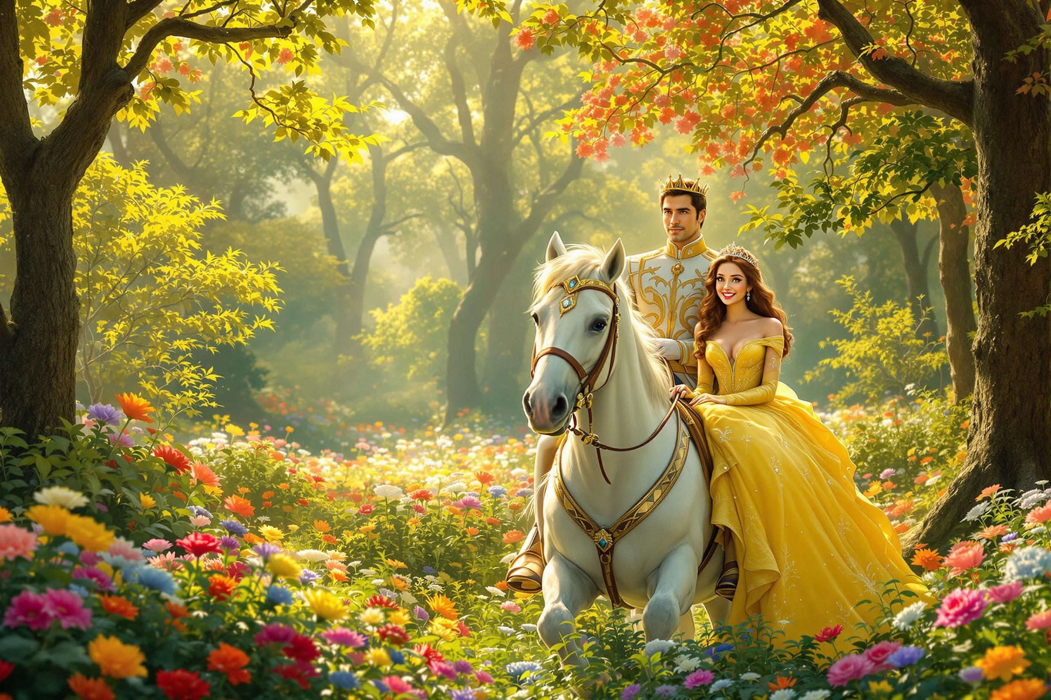
LLM: Prompt
prompt: [Scene Description: A serene and vibrant forest, filled with a variety of trees ranging from towering giants to smaller, more delicate ones. The air is alive with colorful flowers of every shape and size, carpeting the forest floor. A warm, golden light filters through the canopy above, casting dappled shadows across the scene. Character Appearance: Princess: A beautiful young woman, around 20 years old, with a radiant smile and sparkling eyes. She wears a stunning yellow gown, intricately designed and adorned with delicate patterns. A golden crown, set with glittering diamonds, sits atop her luscious hair, which cascades down her back in soft, flowing waves. Character Descriptions: Princess: The princess exudes an aura of innocence and curiosity, her bright yellow dress shining like a ray of sunshine amidst the forest's natural beauty. Her golden crown adds a touch of regality to her overall demeanor. Prince: A handsome man in his mid-thirties, dressed in elegant, princely attire, complete with a crown on his head. He has a confident, chivalrous air about him, and his piercing eyes seem to hold a deep sense of kindness. Character Actions: Princess: Initially, the princess is seen walking through the forest, her eyes scanning the surroundings with wonder, as she stops to admire the various flowers. Later, she is sitting on the prince's horse, looking slightly surprised but also thrilled, with her arms wrapped around the prince's waist. Prince: The prince rides into the scene on his majestic white horse, his eyes fixed on the princess as he approaches her. He dismounts, engages in a brief conversation with the princess, and then offers her a ride on his horse. As they depart, he sits confidently in the saddle, with the princess holding onto him. Focus: The central element of the image is the tender moment between the princess and the prince, as they ride off together into the forest, surrounded by the vibrant colors and lush foliage of nature.]
Scene Description
Character Appearance
Character Description
Character Actions
Focus

Slide 10
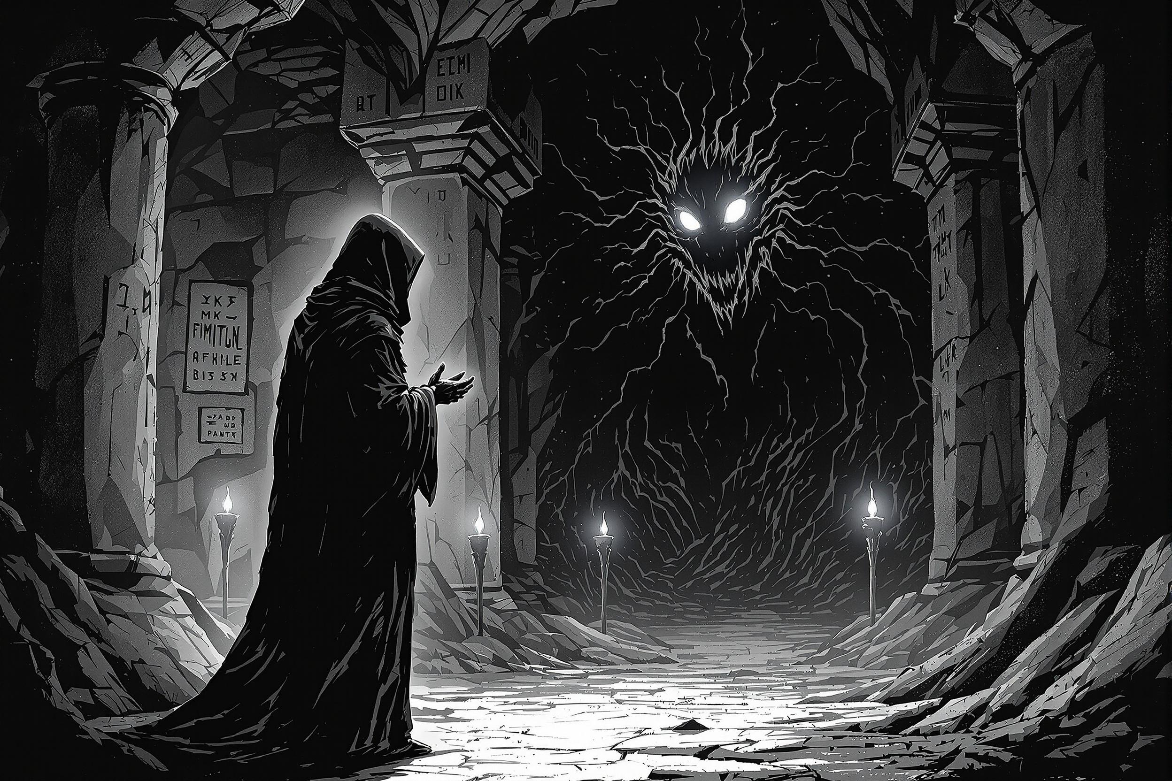
Image Generation
black-forest-labs/flux-1.1-pro-ultra
Using Replicate
Prompt from LLM
Consistent Characters using fixed seed
NSFW Filter Problems

Slide 11
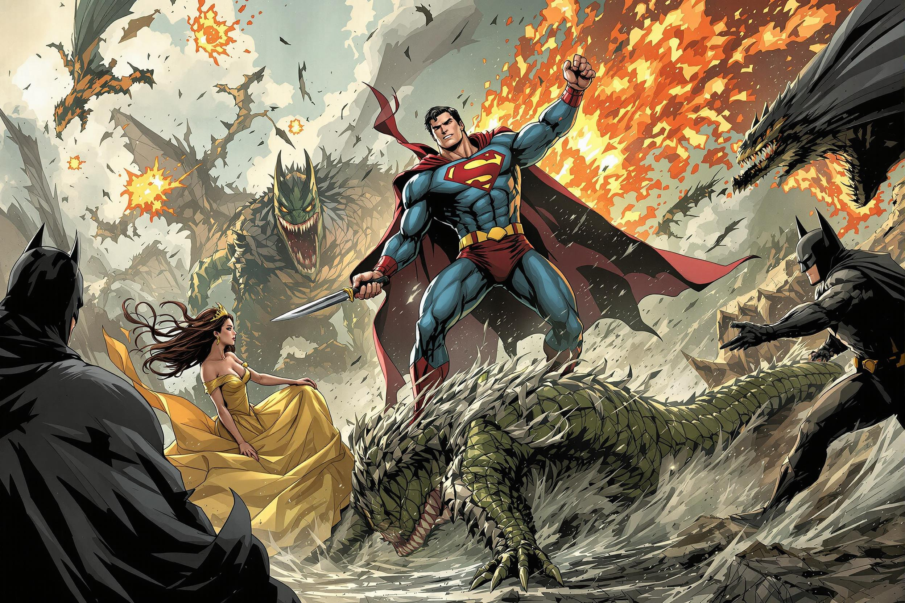
Display Image
Show Image in Discord Chat
Work in Progress
Currently: saved to file

Slide 12
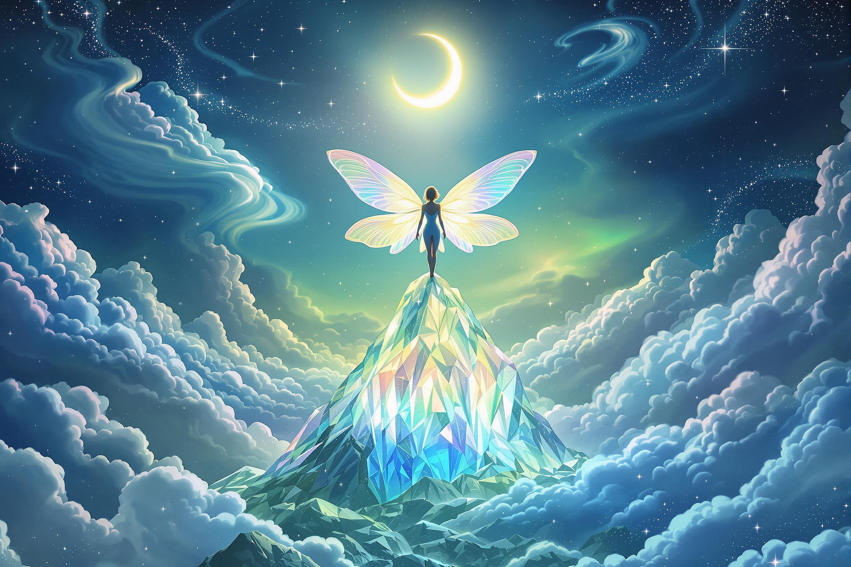
Outlook
Implement Displaying Image
Circumvent NSFW Filter
Improve character continuity
Out of scope
Port to Tabletop

